Slide 1

Giving Computers the Ability to Learn from Data
Concept & Pathway

Slide 2
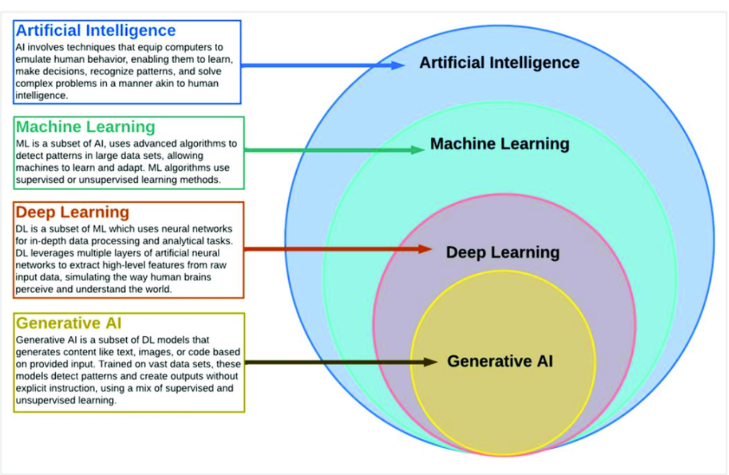
AI, ML, Deep Learning, & Generative AI: How They Relate

Slide 3
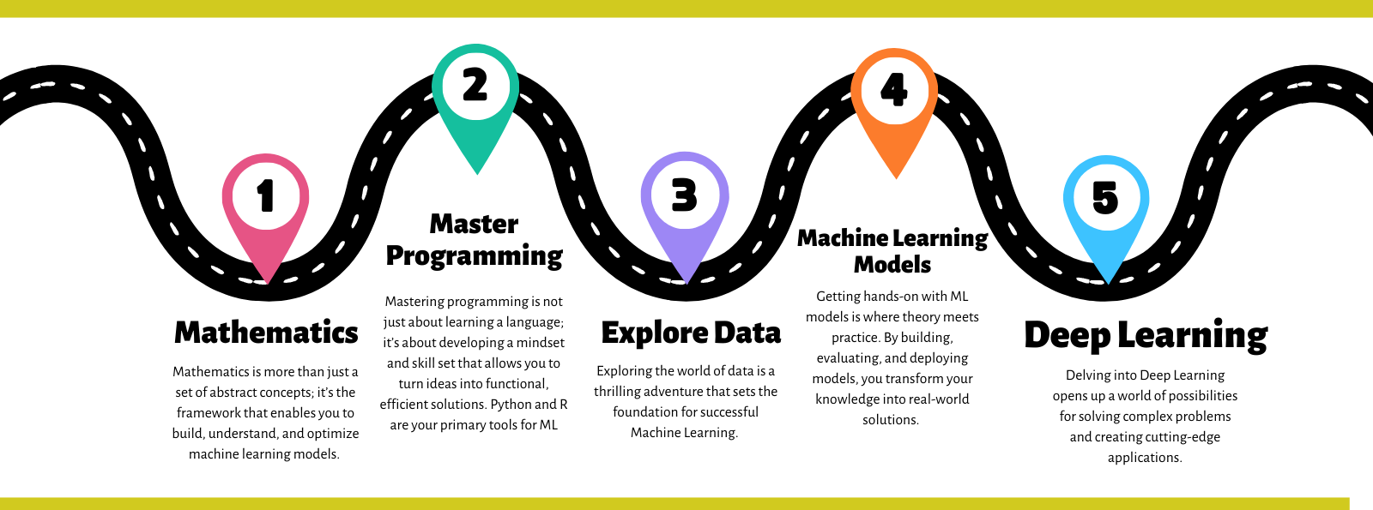
AI Pathway

Slide 4








ML Pathway
Machine Learning
(ML Scientist/ML Engineer/Data Scientist)
Data Engineering
(Data Engineer)
Data Analysis
(Data Analyst/ Data Scientist)
Real World Problem
Raw Data:
Sensors,
Simulations,
Experiments,
Surveys,
Web,
etc.
Process & Store Data:
SQL DBs,
Excel,
CSV Files,
etc.
Clean & Organize Data:
Recognize Data, Restructure Data, Dealing with Missing Data
etc.
Exploratory Data Analysis:
Statistical Analysis, Visualization,
etc.
ML Models:
Predict an Outcome,
Discover Patterns in Data
etc.
Reports,
Visualization,
Mobile Apps,
Websites,
etc …

Slide 5
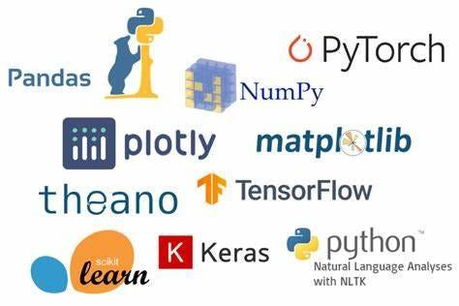
Deep Learning Libraries
PyTorch: Developed by Meta's AI Research lab, it is the primary choice for research and academic prototyping due to its dynamic computation graph, which allows for immediate debugging and on-the-fly model changes.
TensorFlow: A production-grade framework from Google designed for high scalability across mobile, desktop, and cloud environments. It integrates TensorBoard for advanced visualization.
Keras: A high-level, user-friendly API that now acts as the default interface for TensorFlow. It focuses on enabling fast experimentation by allowing developers to build models with very few lines of code.
JAX: A high-performance library from Google used for cutting-edge research, combining a NumPy-like API with automatic differentiation and just-in-time (JIT) compilation for maximum hardware speed.

Slide 6
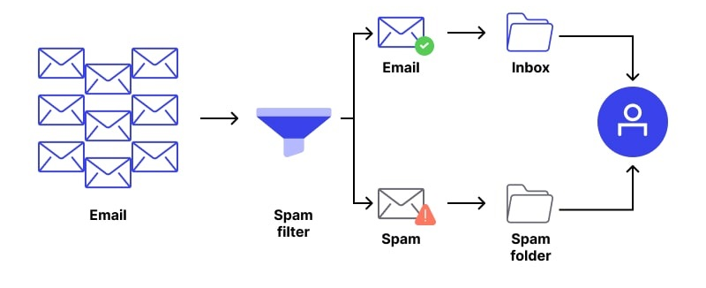

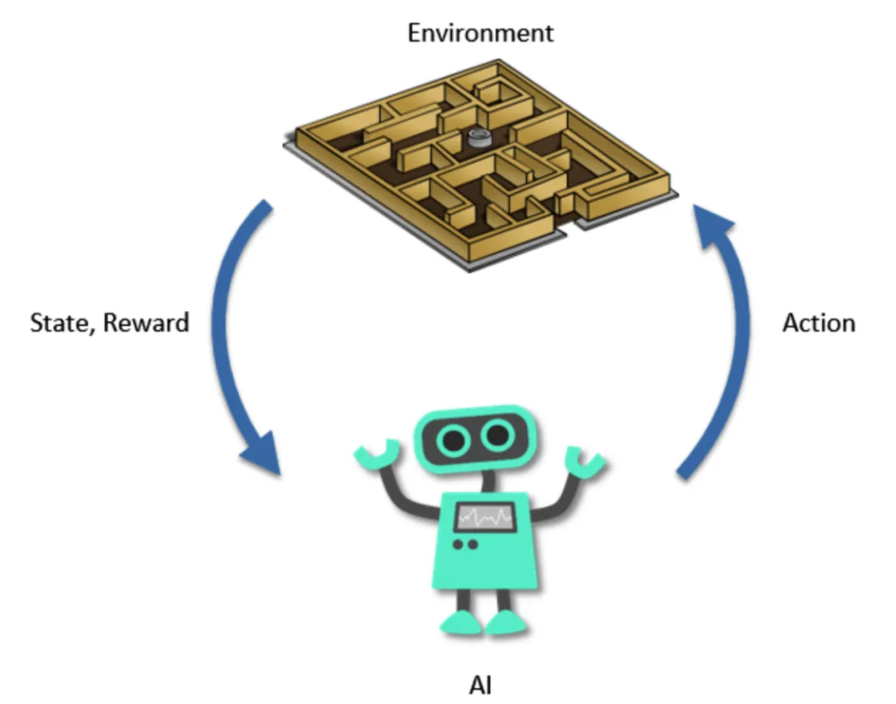
Types of Machine Learning Example
Supervised Learning:
Classification (spam or not spam)
Regression (predicting house prices)
Unsupervised Learning:
Clustering (grouping customers by shopping habits)
Dimensionality reduction (data compression)
Reinforcement Learning
Game playing, self-driving cars

Slide 7
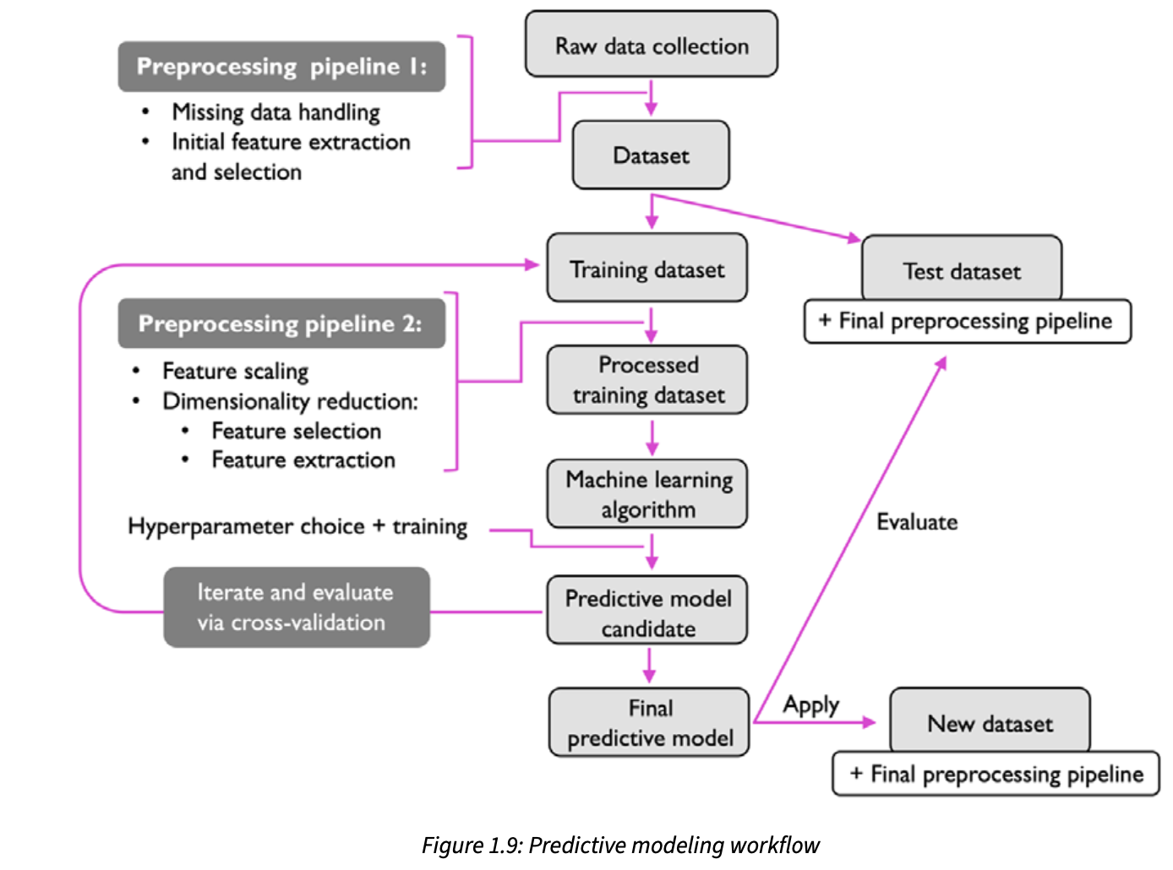
Roadmap for Building ML System
Preprocessing – clean and prepare data.
Training – selecting a model & fit it to data
Evaluation – test how well it works
Prediction – use model for future cases

Slide 8
Question?

Slide 9
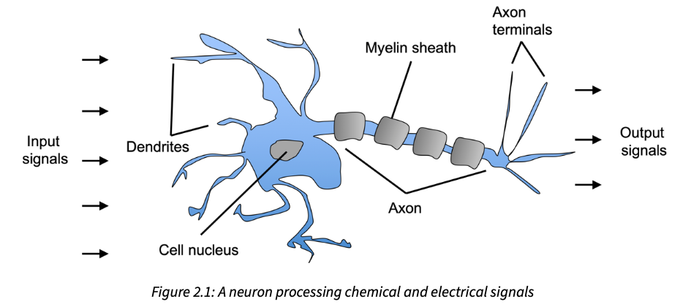
From Biological to Artificial Neurons
A biological neuron consists of three primary components relevant to this abstraction:
Dendrites: Receptors that accept input signals from various sources.
Nucleus (Cell Body): The central processing unit where incoming signals are aggregated.
Axon: The single output mechanism that transmits the processed signal to the dendrites of subsequent neurons.
Inspired by biological neurons (McCulloch-Pitts 1943).
Inputs (features) come in.
Each input has a weight (importance).
All inputs are combined (a weighted sum).
An activation function decides the output.
Notes:
“A biological neuron gets signals, processes them, and fires an output. The perceptron does the same, but with numbers.”
“Think of the perceptron as drawing a straight line to separate two groups of points — like separating cats vs. dogs based on features.”

Slide 10
Single Artificial Neuron/Perceptron
The Perceptron Idea:
Designed by Frank Rosenblatt (1957).
A single perceptron receives numerical inputs, applies a transformation, and produces an output.
To allow the model to learn, these inputs are modified by weights and a bias.
Automatically adjusts weights based on mistakes & learn the optimal weight
Good for classification.
Despite initial computational limitations that led to an "AI Winter," modern computational power has made the perceptron the building block of contemporary deep learning.
Notes:
“A biological neuron gets signals, processes them, and fires an output. The perceptron does the same, but with numbers.”
“Think of the perceptron as drawing a straight line to separate two groups of points — like separating cats vs. dogs based on features.”

Slide 11
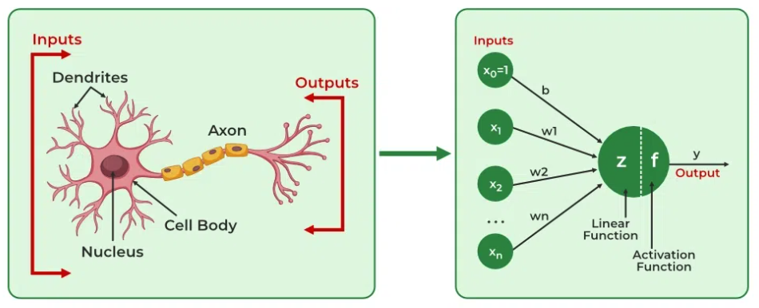
From Biological to Artificial Neurons
Notes:
“A biological neuron gets signals, processes them, and fires an output. The perceptron does the same, but with numbers.”
“Think of the perceptron as drawing a straight line to separate two groups of points — like separating cats vs. dogs based on features.”

Slide 12
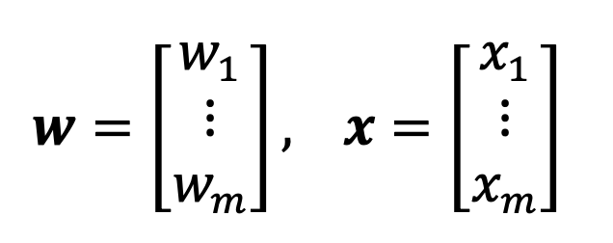
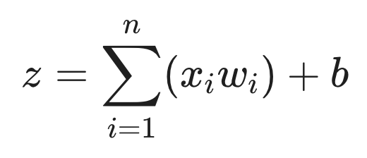
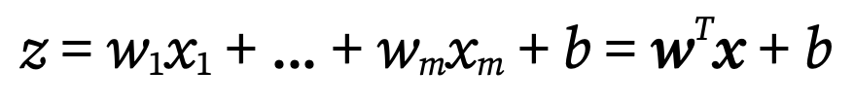
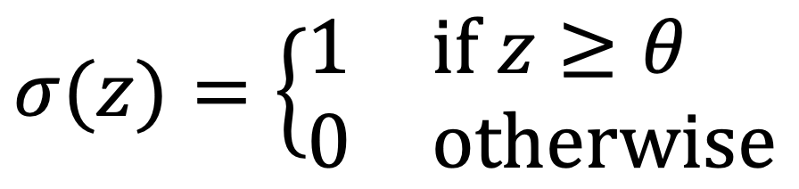
Single Artificial Neuron/Perceptron - Math Notation
Think of the artificial neuron as a yes/no decision maker:
Inputs (x): These are the pieces of information.
Weights (w): Determine the strength or importance of a specific input.
Bias (b): An offset value that acts as a threshold.
The product of the inputs and weights must overcome this bias to have a significant effect on the output.
Weighted Sum (Σ): Multiply inputs by weights and add them up. This gives a single score.
→
Activation Function:
If score passes a certain threshold, the neuron “fires” → outputs 1, otherwise 0.
Notes:
Analogy: Imagine applying for a college:
Inputs = GPA, test score, recommendation letters.
Weights = how much the school cares about each factor.
Weighted sum = overall admission score.
Activation = if score ≥ threshold, you’re accepted; otherwise, rejected.
In the formula for a perceptron (or neuron):
z=w1x1+w2x2+⋯+wnxn+bz
x1​,x2​,…,xn​ = inputs (features).
w1​,w2​,…,wn​ = weights (importance of each input).
b = bias.
The bias is like an extra adjustable constant that shifts the decision boundary left, right, up, or down.
Why Do We Use Bias?
Flexibility in Decision Boundary
Without bias, the decision line/plane must always pass through the origin (0,0).
With bias, we can shift the line anywhere we need.
Example: Spam vs. Not Spam boundary doesn’t always go through (0,0).
Analogy: Light Switch + Dimmer
Weights = how strongly each feature contributes.
Bias = the baseline setting — like adjusting the dimmer before any light is added.
Mathematical Benefit
Bias acts like the “intercept” in linear regression (the +c+ c+c in y=mx+cy = mx + cy=mx+c).
It allows the model to fit data better when the true boundary doesn’t cross the origin.
📌 Example (Easy to Explain in Class)
Imagine you’re deciding if a student passes an exam:
Score=5×hours studied+b\text{Score} = 5 \times \text{hours studied} + bScore=5×hours studied+b
If b=0b = 0b=0: A student who studies 0 hours scores 0.
If b=20b = 20b=20: Even if no hours are studied, the student starts with 20 points (bonus).
So bias sets the baseline before any input is considered.
✅ In summary:
Bias = baseline adjustment.
It lets the neuron “shift” its decision boundary.
Without bias, the model is too rigid and may fail to learn correctly.

Slide 13
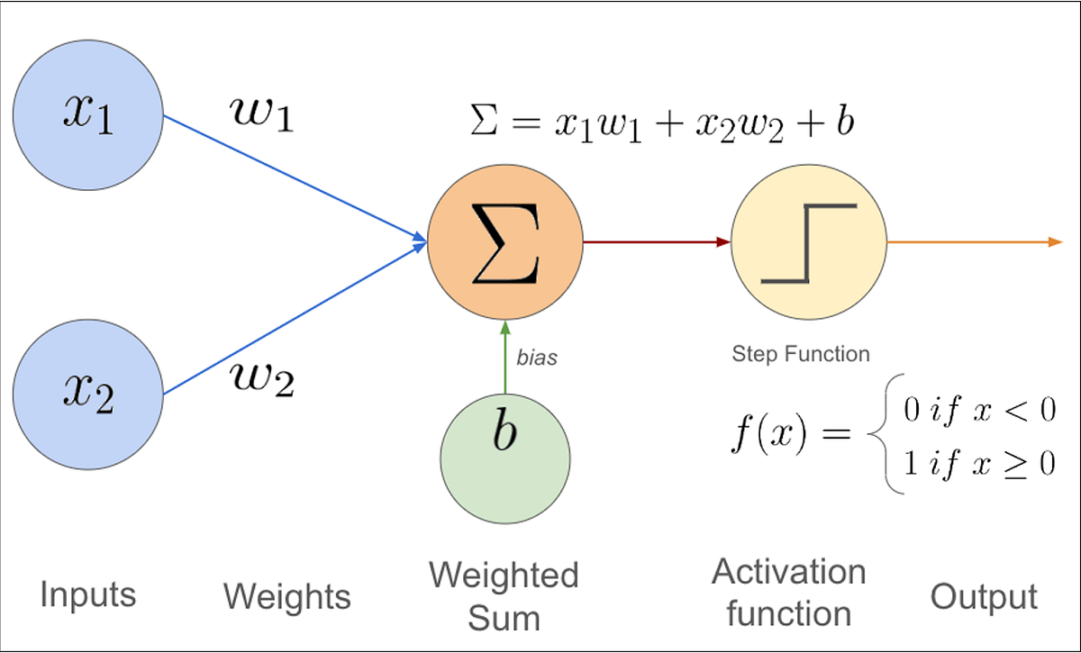
Single Artificial Neuron/Perceptron
Notes:
“A biological neuron gets signals, processes them, and fires an output. The perceptron does the same, but with numbers.”
“Think of the perceptron as drawing a straight line to separate two groups of points — like separating cats vs. dogs based on features.”

Slide 14
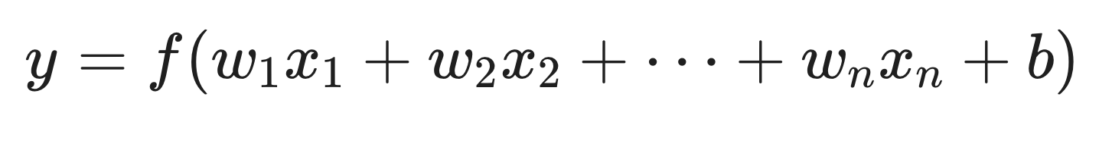
Perceptron vs Linear Regression
The "engine" of both models is exactly the same:
a linear equation calculating the dot product of inputs and weights.
Linear Regression simply outputs the raw continuous value of the linear combination:
The Perceptron takes that exact same linear combination and wraps it in a step function:
The Takeaway: If you take a single artificial neuron (a perceptron) and remove the step function— replacing it with a "linear" or "identity" activation function and train it using Mean Squared Error, you have just built a Linear Regression model.
Notes:
Analogy: Imagine applying for a college:
Inputs = GPA, test score, recommendation letters.
Weights = how much the school cares about each factor.
Weighted sum = overall admission score.
Activation = if score ≥ threshold, you’re accepted; otherwise, rejected.
In the formula for a perceptron (or neuron):
z=w1x1+w2x2+⋯+wnxn+bz
x1​,x2​,…,xn​ = inputs (features).
w1​,w2​,…,wn​ = weights (importance of each input).
b = bias.
The bias is like an extra adjustable constant that shifts the decision boundary left, right, up, or down.
Why Do We Use Bias?
Flexibility in Decision Boundary
Without bias, the decision line/plane must always pass through the origin (0,0).
With bias, we can shift the line anywhere we need.
Example: Spam vs. Not Spam boundary doesn’t always go through (0,0).
Analogy: Light Switch + Dimmer
Weights = how strongly each feature contributes.
Bias = the baseline setting — like adjusting the dimmer before any light is added.
Mathematical Benefit
Bias acts like the “intercept” in linear regression (the +c+ c+c in y=mx+cy = mx + cy=mx+c).
It allows the model to fit data better when the true boundary doesn’t cross the origin.
📌 Example (Easy to Explain in Class)
Imagine you’re deciding if a student passes an exam:
Score=5×hours studied+b\text{Score} = 5 \times \text{hours studied} + bScore=5×hours studied+b
If b=0b = 0b=0: A student who studies 0 hours scores 0.
If b=20b = 20b=20: Even if no hours are studied, the student starts with 20 points (bonus).
So bias sets the baseline before any input is considered.
✅ In summary:
Bias = baseline adjustment.
It lets the neuron “shift” its decision boundary.
Without bias, the model is too rigid and may fail to learn correctly.

Slide 15
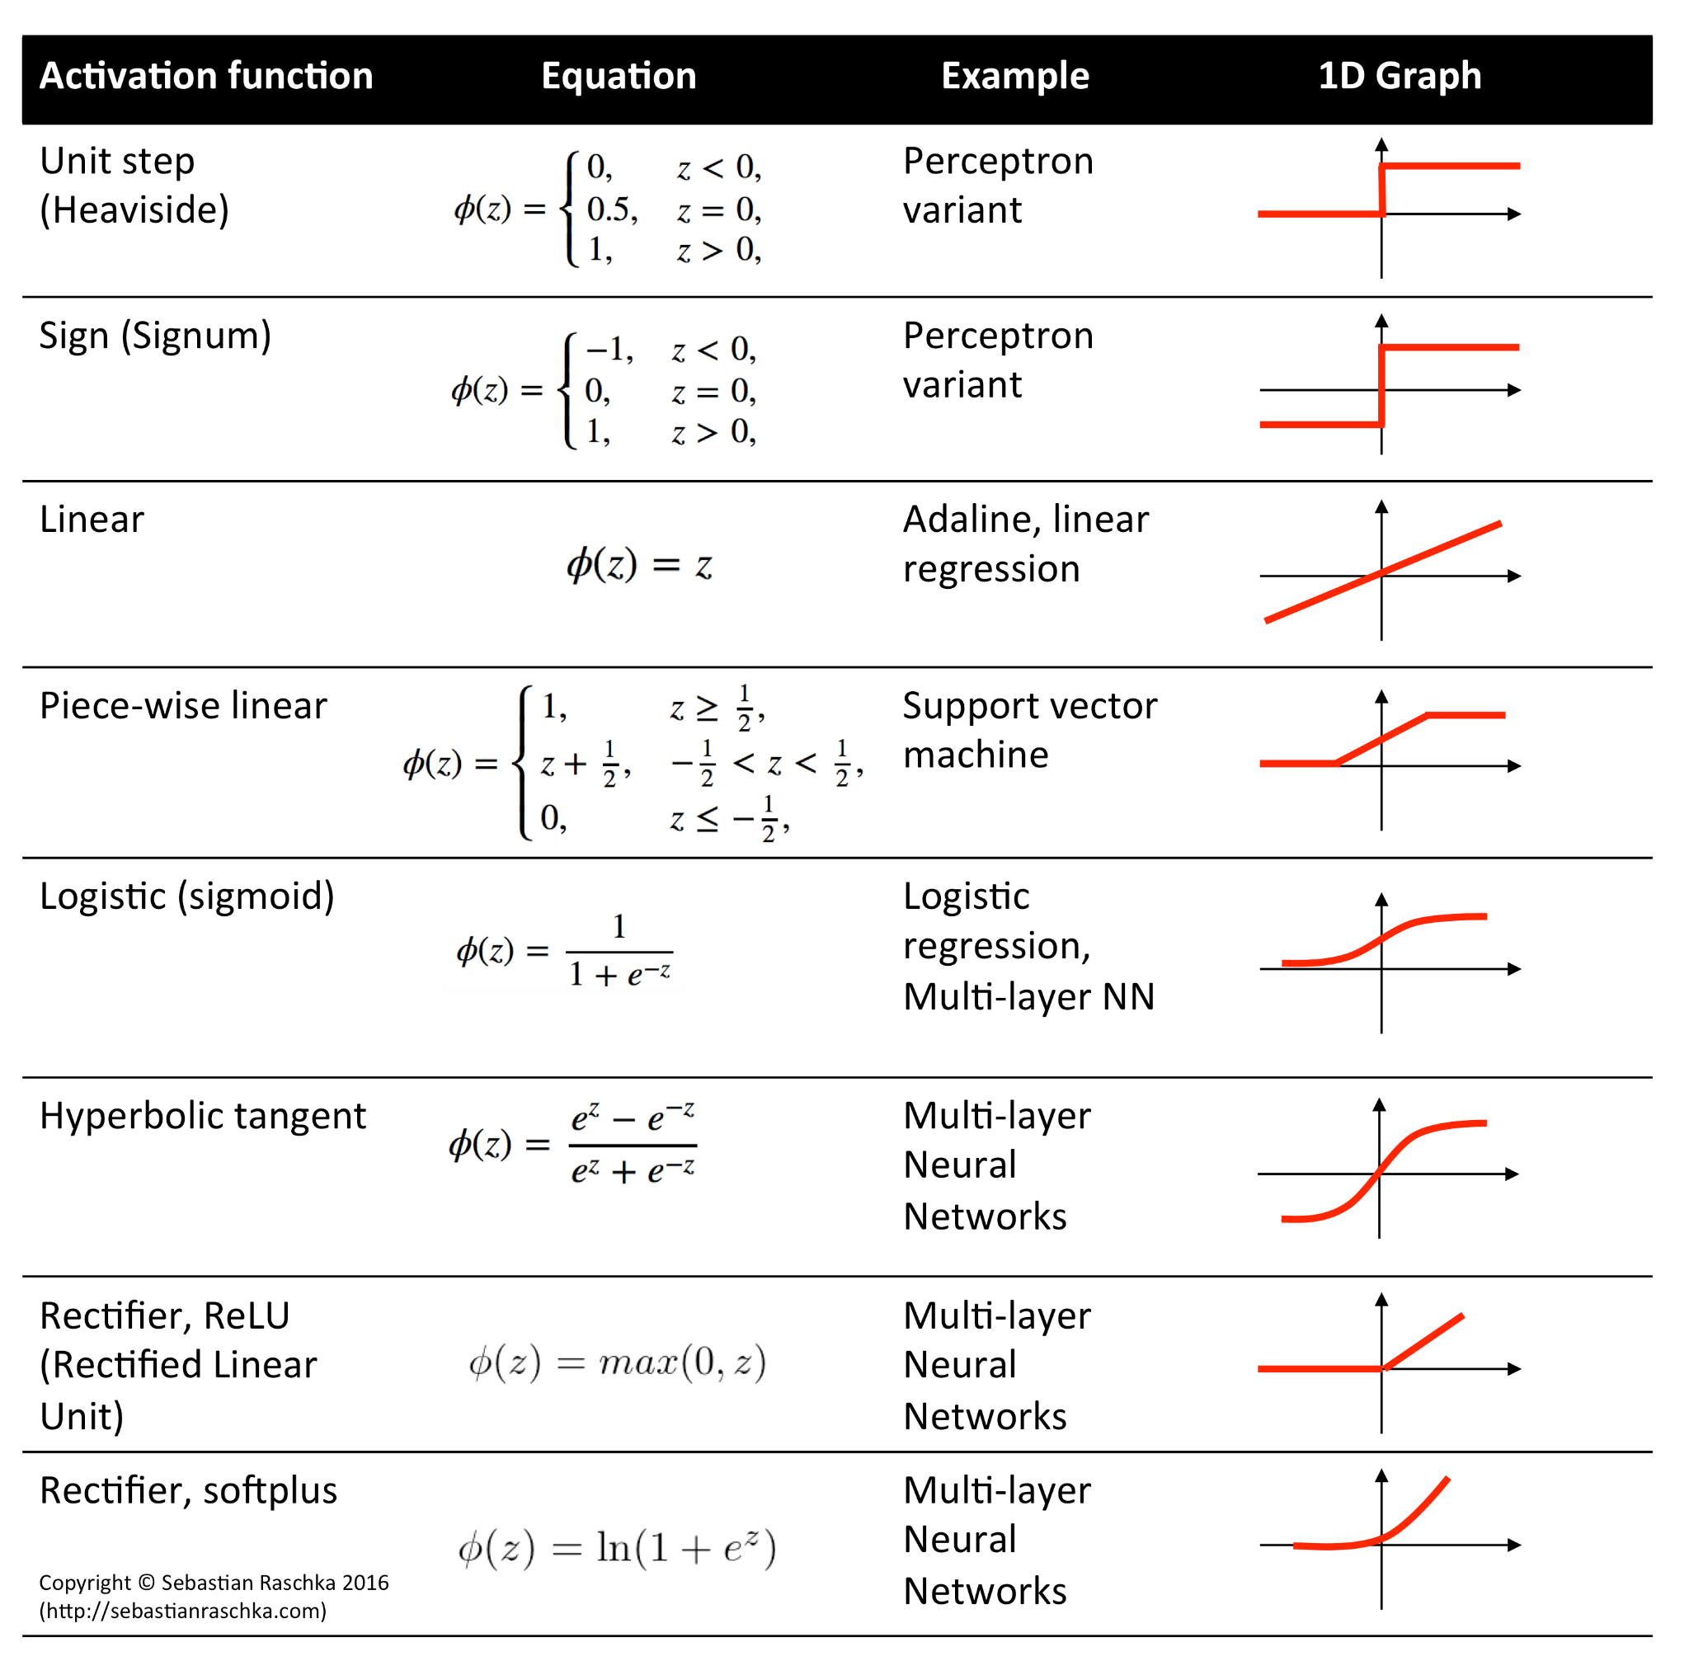
Activation Function
Act as filters, helping to decide which information is relevant & which should be suppressed.
To introduce non-linearity and constrain the output values
https://en.wikipedia.org/wiki/Activation_function
Notes:
Analogy: Imagine applying for a college:
Inputs = GPA, test score, recommendation letters.
Weights = how much the school cares about each factor.
Weighted sum = overall admission score.
Activation = if score ≥ threshold, you’re accepted; otherwise, rejected.
In the formula for a perceptron (or neuron):
z=w1x1+w2x2+⋯+wnxn+bz
x1​,x2​,…,xn​ = inputs (features).
w1​,w2​,…,wn​ = weights (importance of each input).
b = bias.
The bias is like an extra adjustable constant that shifts the decision boundary left, right, up, or down.
Why Do We Use Bias?
Flexibility in Decision Boundary
Without bias, the decision line/plane must always pass through the origin (0,0).
With bias, we can shift the line anywhere we need.
Example: Spam vs. Not Spam boundary doesn’t always go through (0,0).
Analogy: Light Switch + Dimmer
Weights = how strongly each feature contributes.
Bias = the baseline setting — like adjusting the dimmer before any light is added.
Mathematical Benefit
Bias acts like the “intercept” in linear regression (the +c+ c+c in y=mx+cy = mx + cy=mx+c).
It allows the model to fit data better when the true boundary doesn’t cross the origin.
📌 Example (Easy to Explain in Class)
Imagine you’re deciding if a student passes an exam:
Score=5×hours studied+b\text{Score} = 5 \times \text{hours studied} + bScore=5×hours studied+b
If b=0b = 0b=0: A student who studies 0 hours scores 0.
If b=20b = 20b=20: Even if no hours are studied, the student starts with 20 points (bonus).
So bias sets the baseline before any input is considered.
✅ In summary:
Bias = baseline adjustment.
It lets the neuron “shift” its decision boundary.
Without bias, the model is too rigid and may fail to learn correctly.

Slide 16
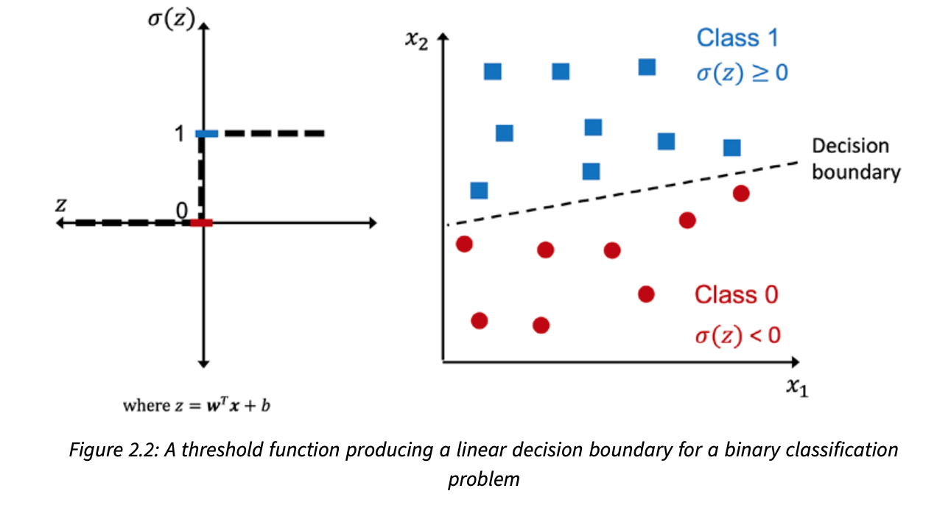
Activation Function in Perceptron
Unit step function

Slide 17
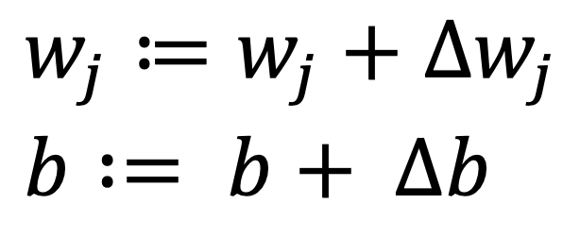
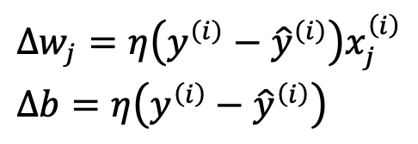
The Perceptron Learning Rule
Initialize the weights and bias unit to 0 or small random numbers
For each training sample:
Compute the output value (the class label predicted by the unit step function)
Update the weights & biases:
If prediction is correct → no change
If prediction is wrong → adjust weights & biases slightly
Repeat until errors are minimized.
Note: The bias and all weights are being updated
simultaneously with the same predicted class.
Learning Rate
True Class
Predicted Class
Notes:
“The perceptron learns by trial and error: every time it makes a mistake, it shifts the boundary to do better next time.”
Plain English Version:
If the perceptron predicts too low, increase the weight.
If it predicts too high, decrease the weight.
Keep repeating until it learns a line that separates the classes.
Analogy: Imagine throwing darts at a target blindfolded:
If dart lands left of the bullseye → adjust to the right.
If dart lands too high → adjust downward.
Over time, you get closer to the bullseye.

Slide 18
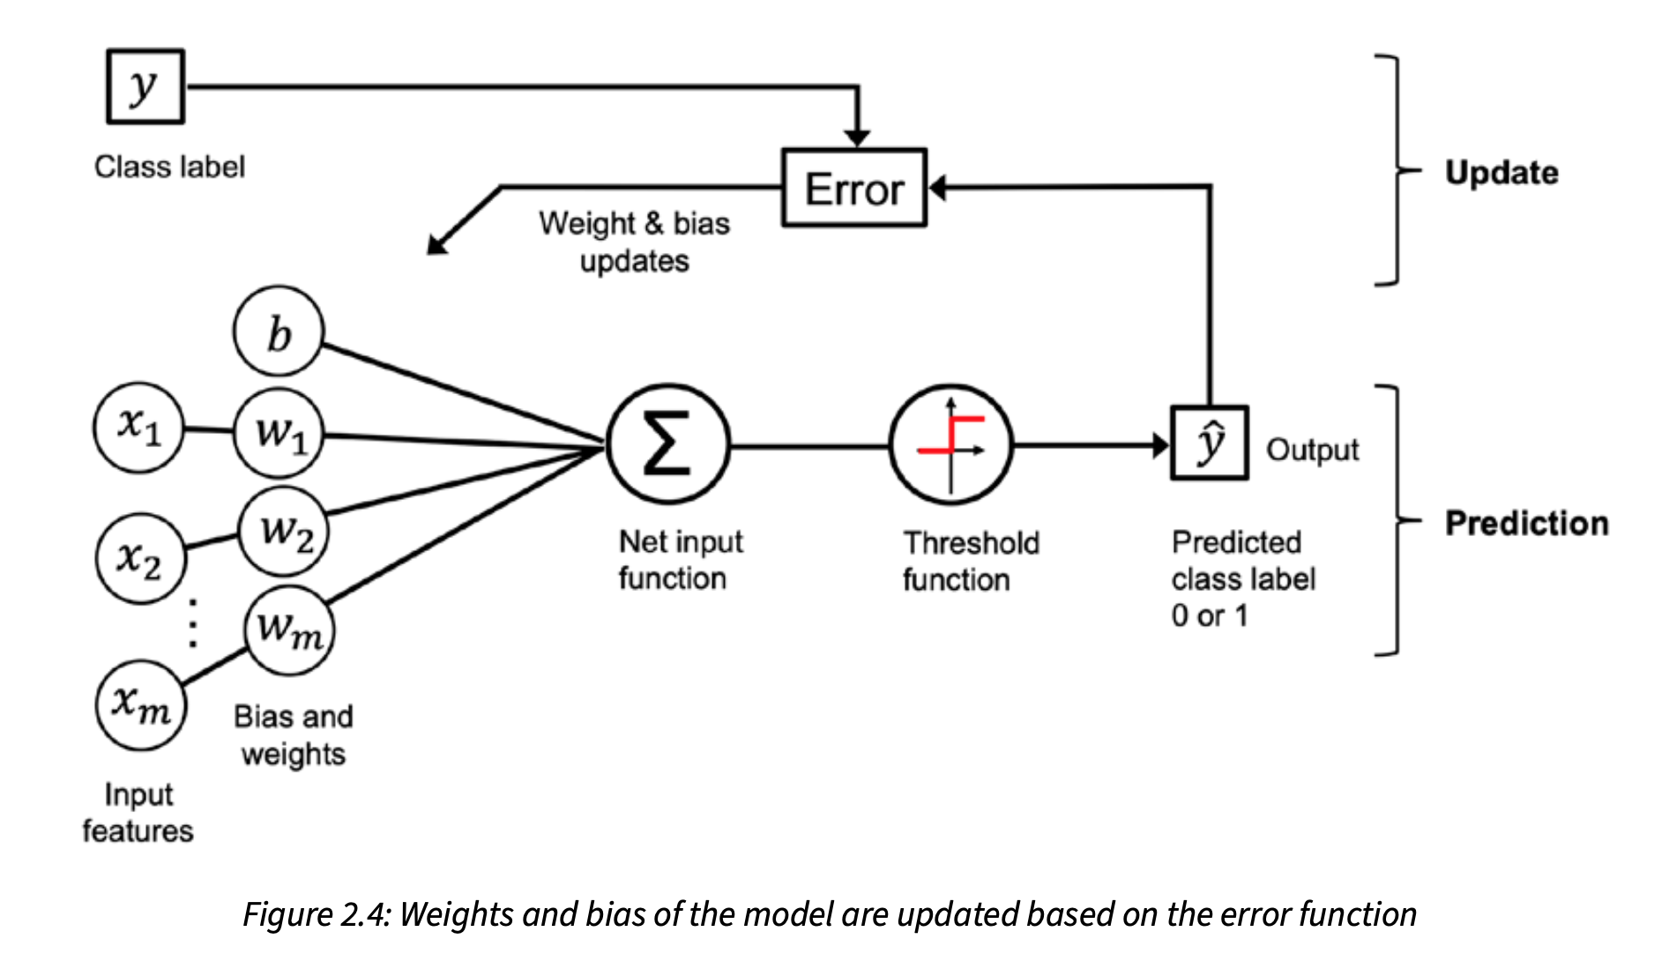
Perceptron Process Overview
Notes:
The preceding diagram illustrates how the perceptron receives the inputs of an example (x) and com- bines them with the bias unit (b) and weights (w) to compute the net input. The net input is then passed on to the threshold function, which generates a binary output of 0 or 1—the predicted class label of the example. During the learning phase, this output is used to calculate the error of the prediction and update the weights and bias unit.

Slide 19
Implementing Perceptron in Python
Chapter 2
Notes:
“Now that we understand what machine learning is, let’s see how we can actually build the simplest model: a perceptron.”

Slide 20
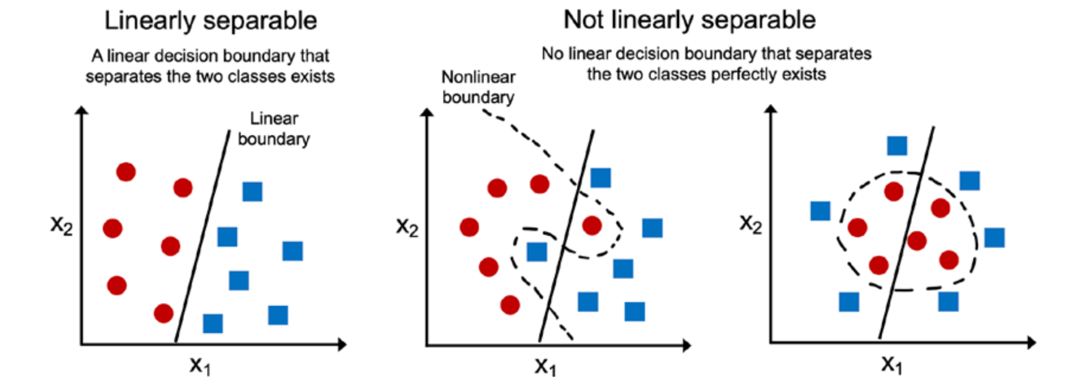
Perceptron Convergence & Limitations
The perceptron only converges if the data is linearly separable.
What will happen if the data is not linearly separable?
The perceptron keeps updating forever.
Endless Oscillation
Solution:
Set a maximum number of epochs (passes over data).
Allow some tolerated errors (misclassifications).

Slide 21
Adaptive Linear Neurons (Adaline)
Use in classification task.
Uses a continuous error measure (linear activation) instead of binary correct/incorrect (step function)
Linear activation function: 𝜎(z) = z (identity function)
Goal: minimize the difference between predicted and true labels.
Now that the output is continuous, we can use optimization techniques like Gradient Descent to minimize the error.
Minimize the Mean Squared Error (MSE)
While the linear activation function is used for learning the weights (training)a threshold function is applied to make the final prediction.
Notes:
The Adaline algorithm is particularly interesting because it illustrates the key concepts of defining and minimizing continuous loss functions. This activation here is the identity function 𝜎(𝑧) = 𝑧.
The key difference between the Adaline rule and perceptron is that the weights are updated based on a linear activation function rather than a unit step function
While the linear activation function is used for learning the weights, we still use a threshold function to make the final prediction, which is similar to the unit step function that we covered earlier.
The main advantage of this continuous linear activation function, in contrast to the unit step function, is that the loss function becomes differentiable. another nice property of this loss function is that it is convex; thus, we can use a very simple yet powerful optimization algorithm called gradient descent to find the weights that minimize our loss function to classify the examples in the Iris dataset.
“Adaline improves on the perceptron by looking at how wrong it is, not just whether it’s wrong.”

Slide 22
Minimizing Loss Functions with Gradient Descent
Chapter 2
Notes:
defining and minimizing continuous loss functions.
In ML, we want our model (Perceptron/Adaline) to make correct predictions.
To know how “wrong” the model is, we calculate a loss function (like a score of how bad it’s doing). 👉 We want the lowest possible loss → better predictions.
Gradient Descent is an algorithm that helps us to minimize the loss

Slide 23
Loss Functions
A loss function (Cost function or Objective function) measures how wrong the model is
It gives the model a score → lower is better
Training = adjusting weights to minimize the loss
Common Loss Functions
Mean Squared Error (MSE) → Regression (continuous predictions)
Mean Absolute Error (MAE) → Regression, less sensitive to outliers
Cross-Entropy Loss → Classification problems
Hinge Loss → Support Vector Machines
0–1 Loss → Counts misclassifications

Slide 24
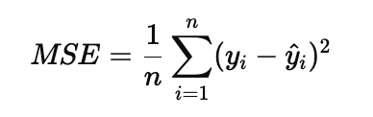
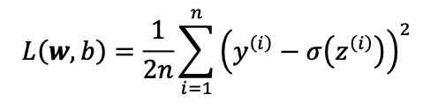
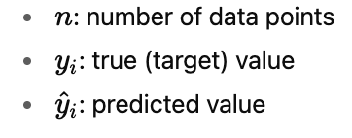
Mean Squared Error (MSE)
Measures the average of the squared differences between the predicted and the actual values.
Square: ensures all errors are positive and punishes large errors more.
Mean: averages the errors across all samples
Intuition: On average, how far are our predictions from the truth?
Notes:
💡 Why Square?
If we only took raw errors (yi−y^iy_i - \hat{y}_iyi​−y^​i​), positives and negatives cancel out.
Squaring ensures every mistake counts, and big mistakes hurt more.
The term is just added for our convenience and will make it easier to derive the gradient of the loss
another nice property of this loss function is that it is convex; thus, we can use a very simple yet powerful optimization algorithm called gradient descent to find the weights that minimize our loss function to classify the examples in the Iris dataset.
Convex Loss Function
A convex function is shaped like a bowl (U-shape).
This means there is only one lowest point (the global minimum).
If you roll a ball inside the bowl, it will always settle at the bottom.
In ML, this bottom is the best weights for your model
Why Convex is Nice
No tricky “traps” (local minima) to get stuck in.
Guarantees gradient descent can find the best solution.

Slide 25
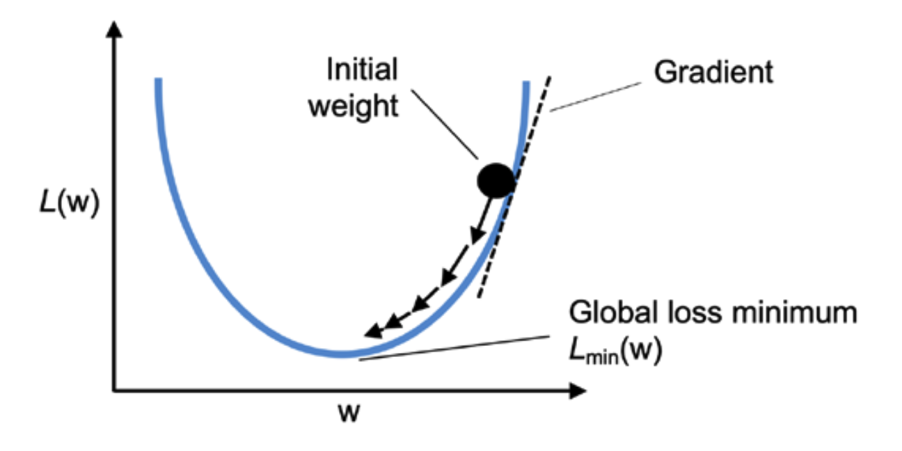
Gradient Descent
A method to find the minimum of a function (like our loss function).
Helps the model learn the best weights to make accurate predictions.
Think of it as going downhill to reach the lowest point.
Intuitive Analogy
Imagine standing on a hilly landscape in the fog.
Your goal: reach the bottom of the valley.
You can’t see far, but you can feel the slope under your feet.
Each step you take downhill = one weight update.
How It Works in ML
Calculate loss (how wrong the model is)
Compute gradient (the slope of the loss)
Update weights a little in the opposite direction of the slope
Repeat until loss is small
Notes:
Why We Do It
The loss function tells us “how wrong we are.”
Gradient descent gives us a systematic way to adjust weights so the model improves over time.
Without minimizing loss, the model would just guess randomly and never learn.
"We don’t see the square in the code because we’re not directly minimizing the error — we’re minimizing its square. When you take the derivative, the square cancels one power out, leaving just the error term in the update rule."

Slide 26
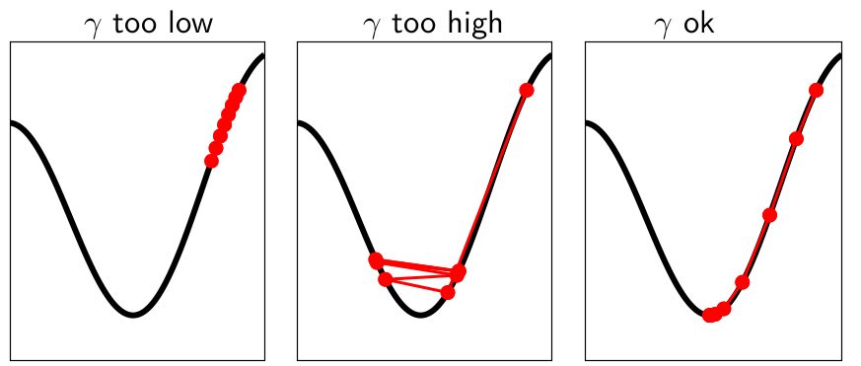

Choosing Learning Rate
Learning Rate Controls Step Size
Too small:
Updates are tiny → convergence is very slow
Might take forever to reach minimum
Too large:
Updates overshoot minimum → divergence
Loss may oscillate or explode
L(W)
W
W
W

Slide 27
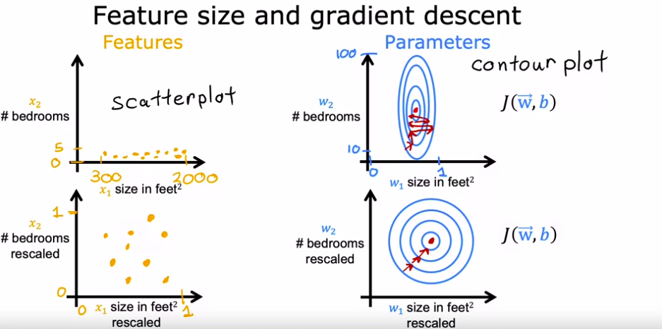
Feature Scaling
Why Feature Scaling?
Gradient descent works better when all features are on similar scale.
Otherwise, large scale differences make gradient point in “wrong” directions → zig-zag path, slower convergence

Slide 28
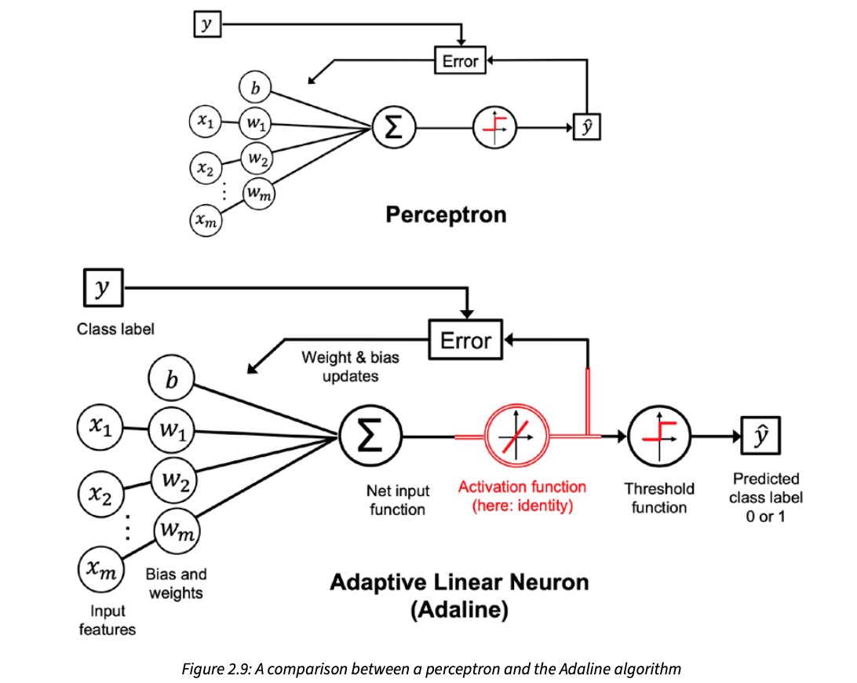
Perceptron vs Adaline
Notes:
The preceding diagram illustrates how the perceptron receives the inputs of an example (x) and com- bines them with the bias unit (b) and weights (w) to compute the net input. The net input is then passed on to the threshold function, which generates a binary output of 0 or 1—the predicted class label of the example. During the learning phase, this output is used to calculate the error of the prediction and update the weights and bias unit.

Slide 29
Adaline Convergence & Limitations
The Adaline can NOT successfully classify non-linearly separable data (same as perceptron)
What will happen if the data is not linearly separable?
It will converge & Settling for the "Best Fit"
It will systematically slide down the error gradient until it reaches the mathematical minimum.

Slide 30
Implementing Adaline in Python
Chapter 2
Notes:
“Now that we understand what machine learning is, let’s see how we can actually build the simplest model: a perceptron.”

Slide 31
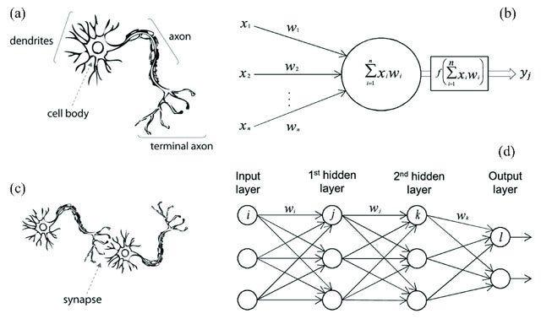
From Biological to Artificial Neurons
Notes:
“A biological neuron gets signals, processes them, and fires an output. The perceptron does the same, but with numbers.”
“Think of the perceptron as drawing a straight line to separate two groups of points — like separating cats vs. dogs based on features.”

Slide 32
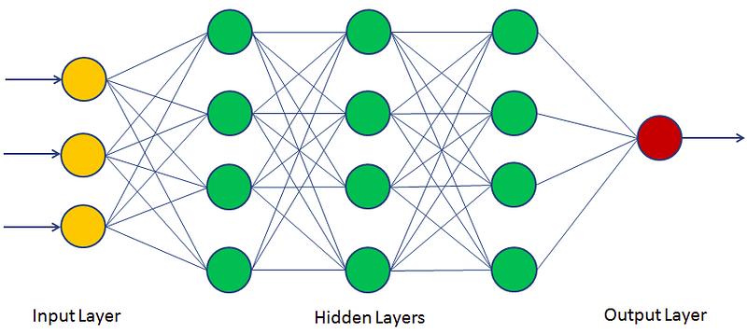
Network Architecture: The Multi-Layer Perceptron
A single perceptron is insufficient for modeling complex, non-linear systems.
MLP or Artificial Neural Network: A collection of interconnected perceptrons organized into layers
Structural Components
Input Layer: Receives raw data or features.
Hidden Layers: Layers between input & output.
A network with two or more hidden layers is a Deep Neural Network.
Output Layer: Delivers the final prediction.
Key Characteristics
Feed-Forward: Information travels strictly in one direction—from input to output.
Fully Connected: Every neuron in one layer links to every neuron in the next.
Universal Approximation Theorem: A network with at least one hidden layer can approximate any continuous, convex function, provided it has enough neurons.
Notes:
Network Architecture: The Multi-Layer Perceptron
A single perceptron is insufficient for modeling complex, non-linear systems. To solve advanced problems, perceptrons are grouped into interconnected layers, forming a Multi-Layer Perceptron (MLP) or an Artificial Neural Network.
Structural Layers
Input Layer: The first layer that directly receives raw, tabular data or feature sets.
Hidden Layers: Layers situated between the input and output. They are considered "hidden" because their outputs are not directly observable in the training data. A network with two or more hidden layers is classified as a Deep Neural Network.
Output Layer: The final layer that provides the network's prediction or estimate (e.g., a continuous value for regression, or probability distributions for classification).
In a Feed-Forward Fully Connected Network, information moves strictly in one direction (from input to output), and every neuron in one layer is connected to every neuron in the subsequent layer.
The Universal Approximation Theorem: Mathematical proofs demonstrate that a neural network with at least one hidden layer containing a sufficient number of neurons can approximate any continuous, convex function.

Slide 33
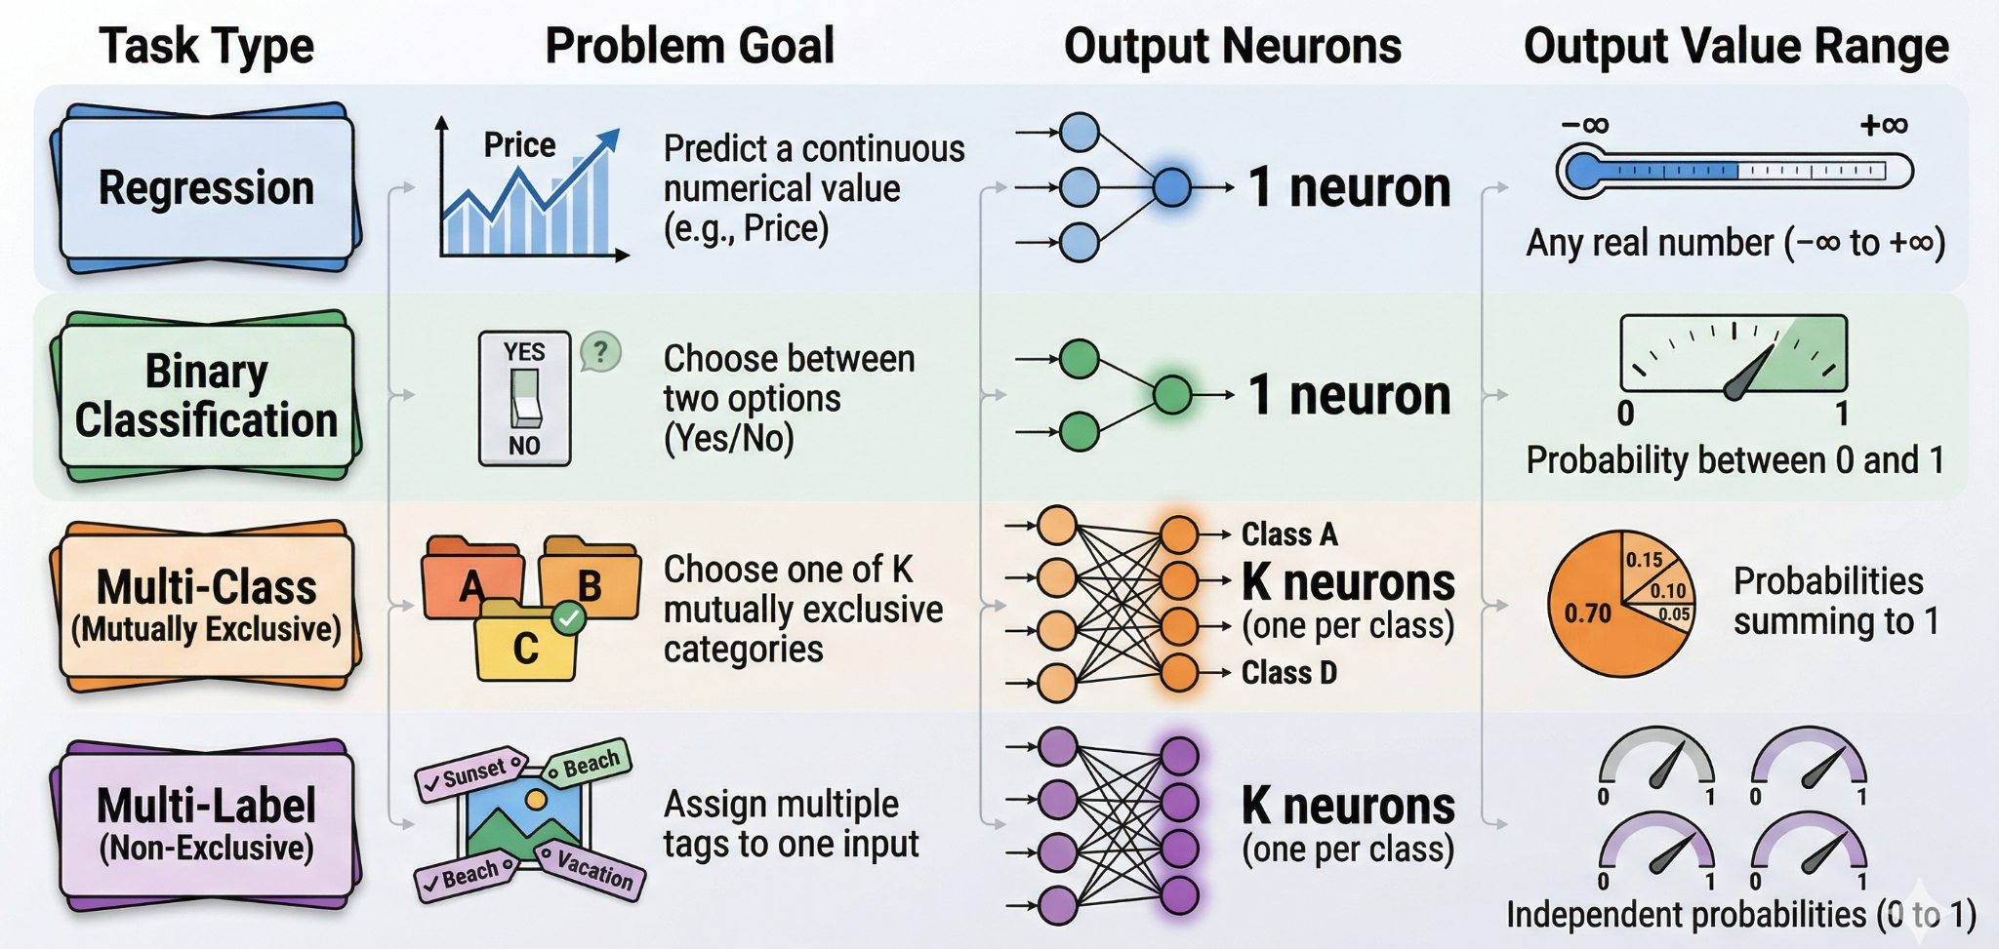
Output Layer Architecture by Task Type
Notes:
The design of the output layer is determined entirely by the type of problem you are trying to solve.
Visualizing the Architecture
1. Regression (Predicting a Quantity)
Example: Predicting house prices based on square footage.
Output: A single node that outputs a raw number. Usually uses a Linear activation (no change) or ReLU (if the value must be positive).
2. Binary Classification (Predicting a Category)
Example: Determining if an email is "Spam" or "Not Spam."
Output: A single node. We interpret the output as the probability of the "positive" class.
Activation: Sigmoid (squashes the value between 0 and 1).
3. Multi-Class / Multi-Label (Predicting Multiple Categories)
Example: Identifying if an image is a "Dog," "Cat," or "Bird."
Output: $N$ nodes, where $N$ is the number of possible categories.
Activation: Softmax (for "pick one") or Sigmoid (for "pick many").
Case 1: Binary Classification
Activation: Sigmoid
Loss: Binary Cross-Entropy
✔ One output neuron ✔ Predicts probability of class 1
Case 2: Multi-Class (Mutually Exclusive)
👉 Example: Cat vs Dog vs Bird (only ONE correct)
Activation: Softmax
Loss: Categorical Cross-Entropy
✔ Outputs sum to 1 ✔ Exactly one class is correct
Case 3: Multi-Label (Non-Exclusive)
👉 Example: Image can contain dog AND car AND person
Activation: Sigmoid (per class)
Loss: Binary Cross-Entropy (applied per class)
✔ Multiple labels can be 1 ✔ Each class is treated independently

Slide 34
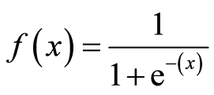
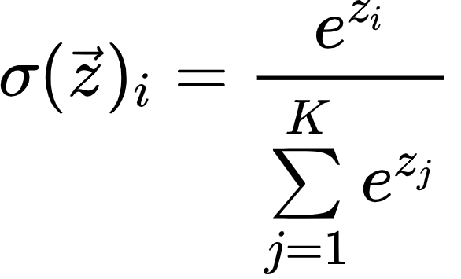
Handling Multi-Class Problems
Data Preparation: One-Hot Encoding
Neural networks require numerical inputs. Categories are converted into binary vectors.
Non-Exclusive (Multi-Label) Classification
Scenario: A data point can belong to multiple classes at once.
Output Setup: One neuron per class.
Activation Function: Sigmoid applied to each neuron individually.
Result: Each class gets its own probability (0 to 1), independent of the others.
Mutually Exclusive (Multi-Class) Classification
Scenario: A data point belongs to exactly one class.
Output Setup: One neuron per class.
Activation Function: Softmax.
The Logic: It squashes all outputs so they sum to 1.0 (100%),
Softmax creates a competition between classes. Increasing one probability decreases others
Notes:
Handling Multi-Class Problems
When a classification task involves more than two categories, the output layer must be expanded to contain multiple neurons—typically one neuron per class. The approach depends on whether the classes are mutually exclusive.
Data Representation: One-Hot Encoding
Text-based categories (e.g., "Red", "Green", "Blue") cannot be processed mathematically. Data must be transformed using one-hot encoding, creating a matrix where a value of 1 indicates the presence of a class, and 0 indicates its absence.
Non-Exclusive Classes (Multi-Label)
Definition: A single data point can belong to multiple categories simultaneously (e.g., a photo tagged as both "Beach" and "Vacation").
Activation: The Sigmoid function is applied to each output neuron independently. This allows multiple neurons to output a probability higher than a defined threshold (e.g., 0.5), assigning multiple labels to the input.
Mutually Exclusive Classes (Multi-Class)
Definition: A single data point can only belong to one category (e.g., an image is either grayscale OR color).
Activation: The Softmax function is utilized. Softmax calculates the probability distribution across all possible target classes, ensuring that the sum of all output probabilities equals exactly 1. The class with the highest probability is chosen as the prediction.
$$softmax(z_i) = \frac{e^{z_i}}{\sum_{k=1}^{K} e^{z_k}}$$

Slide 35
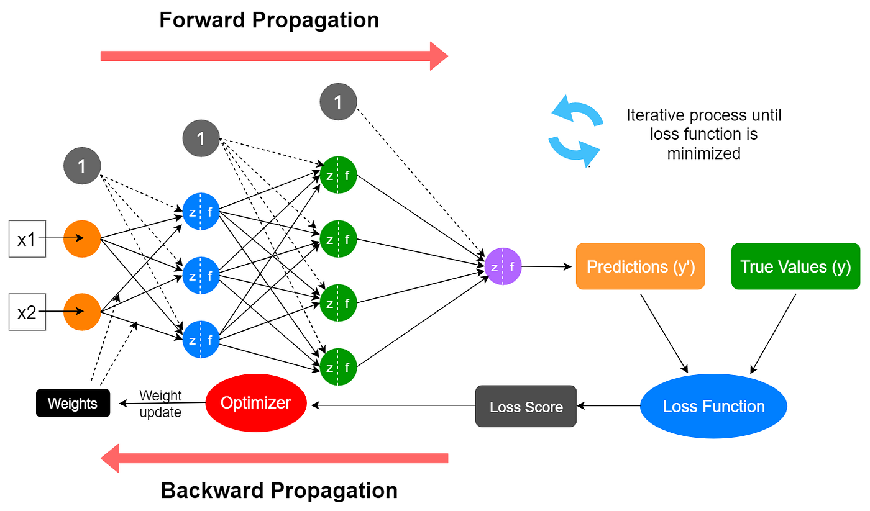
Neural Network Learning Process / Training Loop

Slide 36
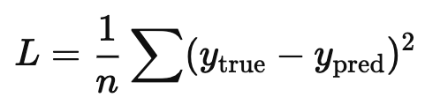
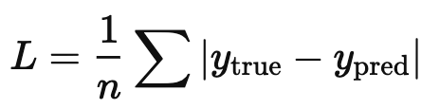
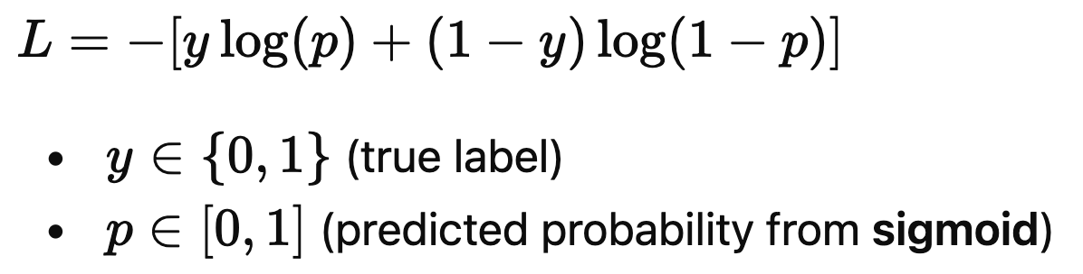
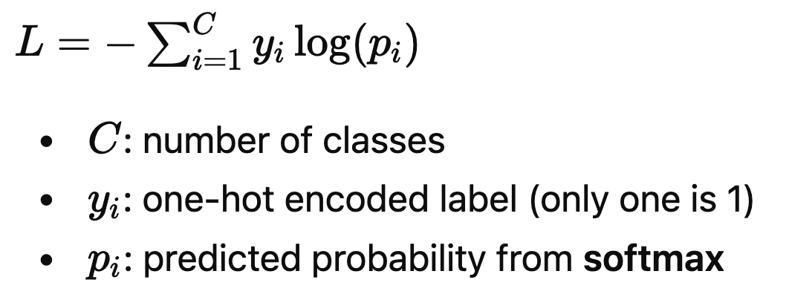
Cost Functions: Quantifying Network Performance
A loss function measures how far the model’s predictions are from the true values during training,
It quantifies “how wrong” the model is & usd by optimization algorithms to guides the learning process
Lower loss ⇒ better model performance
Goal: To minimize this cost
Common Types of Loss/Cost Functions:
Regression
Mean Squared Error (MSE)
Mean Absolute Error (MAE)
Classification
Binary Cross-Entropy (BCE)
Used for: Binary classification & Multi-label classification
Categorical Cross-Entropy (CCE)
Used for: Multi-class classification (mutually exclusive)

Slide 37
Gradient Descent and Optimization
NN contain thousands parameters → cost function is a highly complex, multi-dimensional surface.
Finding the minimum of this function analytically is computationally impossible. Instead, an iterative optimization algorithm called Gradient Descent is used.
The Mechanism of Gradient Descent
GD calculates the gradient of the cost function with respect to the network's weights and biases.
The network then takes a "step" in the opposite direction of the gradient to reach the minimum cost.
Learning Rate: Determines the size of the step taken.
LR dose not need to be constant and can be adjucted during training using adaptive optimization method.
L(W)
W
W
W

Slide 38
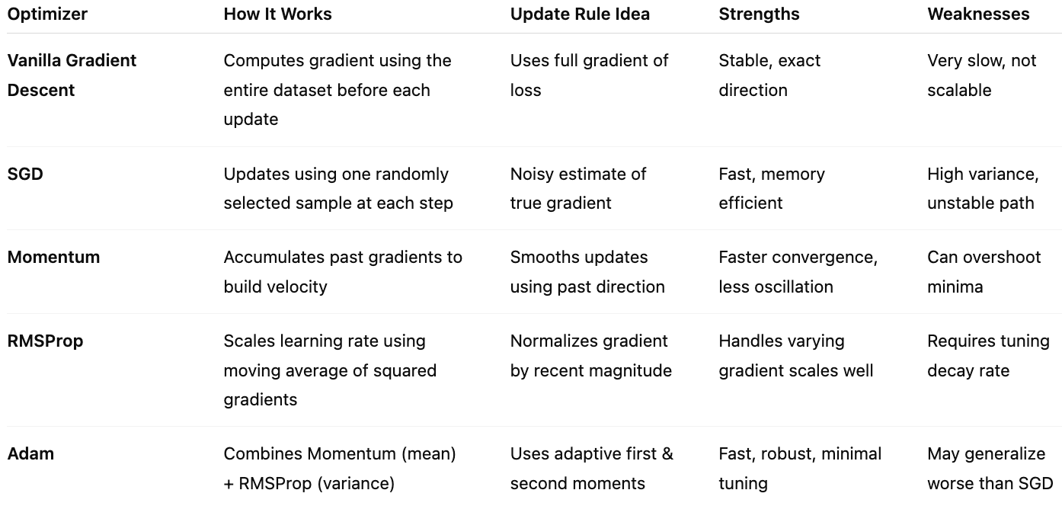
Gradient Descent Variants

Slide 39
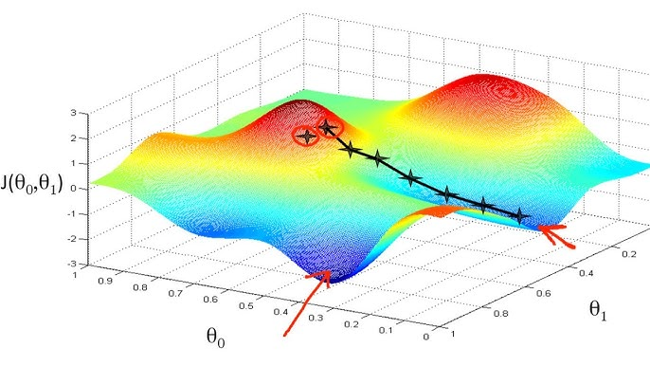
Gradient Descent and Optimization

Slide 40
Neural Network Learning Process / Training Loop

Slide 41
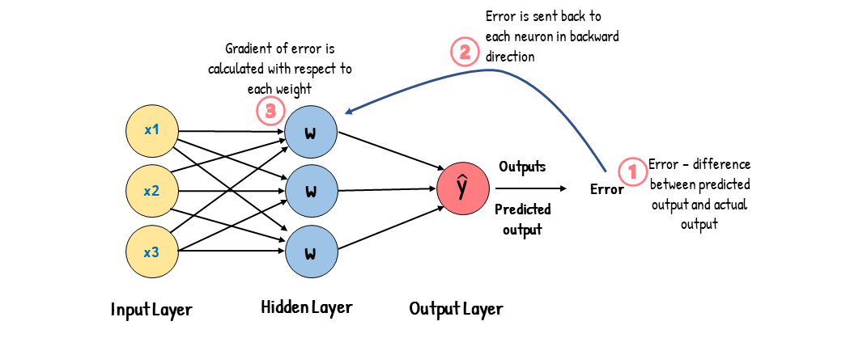
BackPropagation

Slide 42
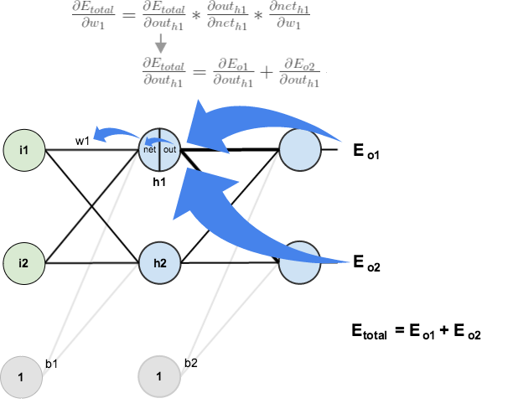
BackPropagation
https://www.geeksforgeeks.org/machine-learning/backpropagation-in-neural-network/

Slide 43
Question?

Slide 44
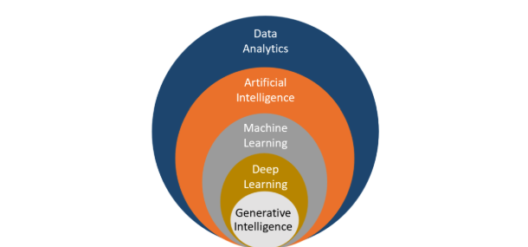
How it all fits together!
Uses various techniques, including machine learning & deep learning, to create systems that mimic human-like intelligence, reasoning, & problem-solving.
The process of examining, cleaning, transforming, and interpreting data to discover useful insights and support decision-making.
Focuses on neural networks with many layers. It excels at tasks involving unstructured data like images, audio, and natural language.
Involves the use of algorithms to enable computers to learn from data and make predictions or decisions.
Focuses on creating systems capable of generating new and creative content, such as text, images, or music, in a human-like manner.

Slide 45
A Refresher
Computer Science is about studying how to use Algorithms to solve problems
Algorithms: Sequences of instruction that does a task and leads to a solution.
Program: Algorithms expressed in a language the computer can understand.
Artificial Intelligence:
Capability of computer systems to perform tasks typically associated with human intelligence
Programming is Thinking, not Typing.
AI vs Programming:
While traditional programmes follow fixed instructions,
AI has the ability to learn, adapt, and make decisions based on the data it processes

Slide 46
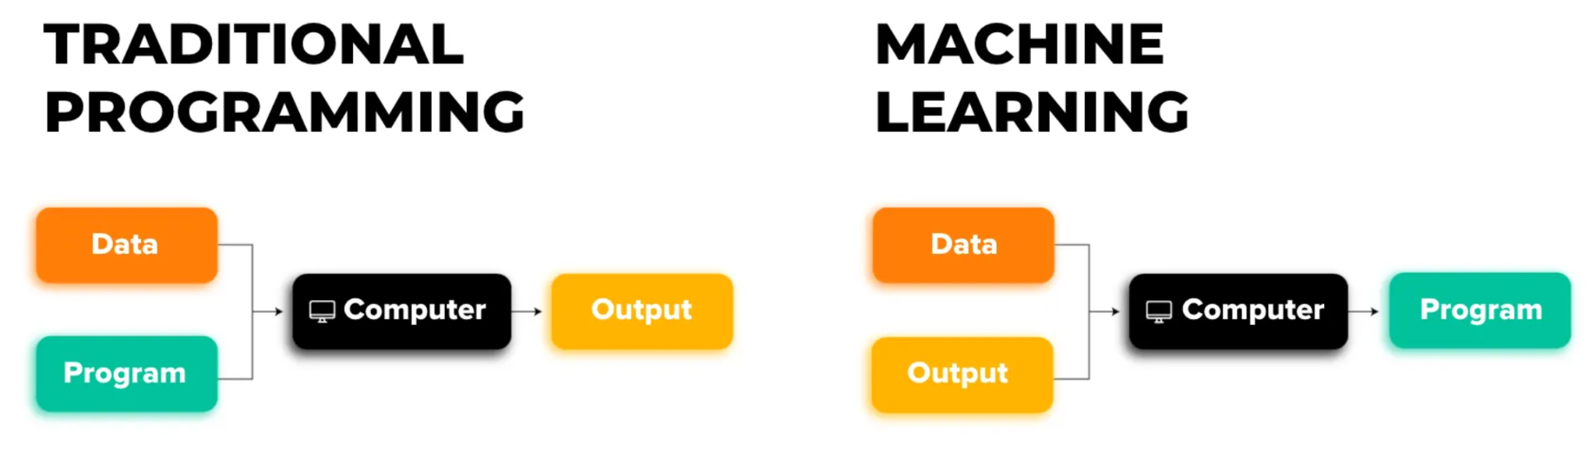
What is Machine Learning?
Computers learning from data
Algorithms improve with experience
Not explicitly programmed with rules

Slide 47
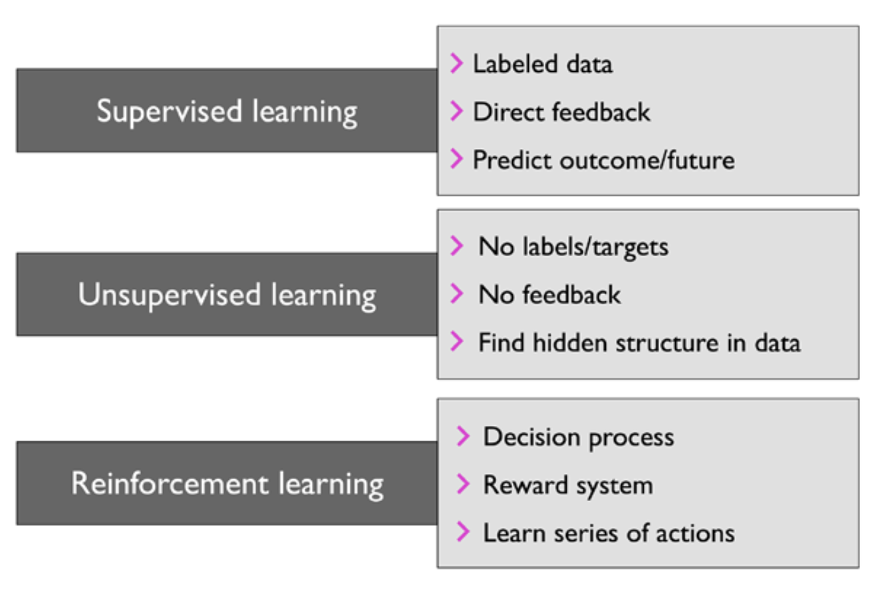
Types of Machine Learning

Slide 48
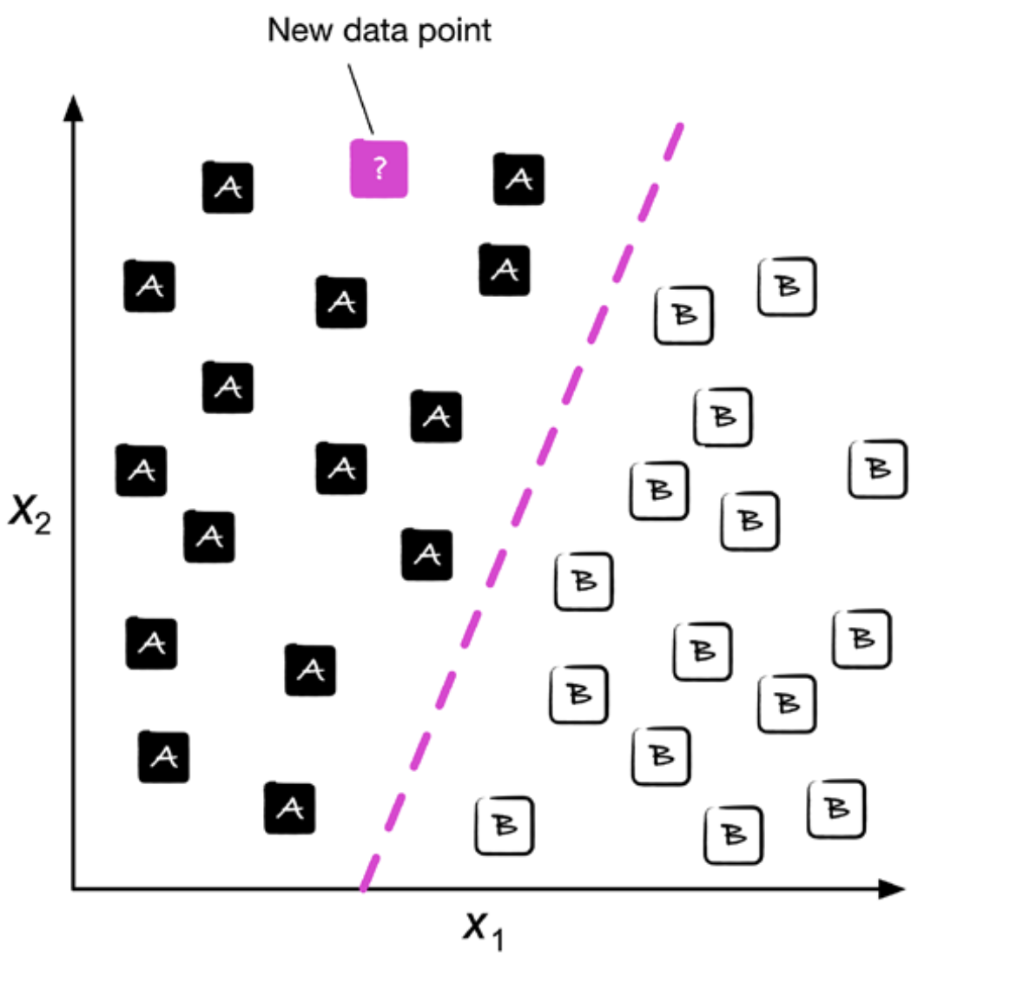
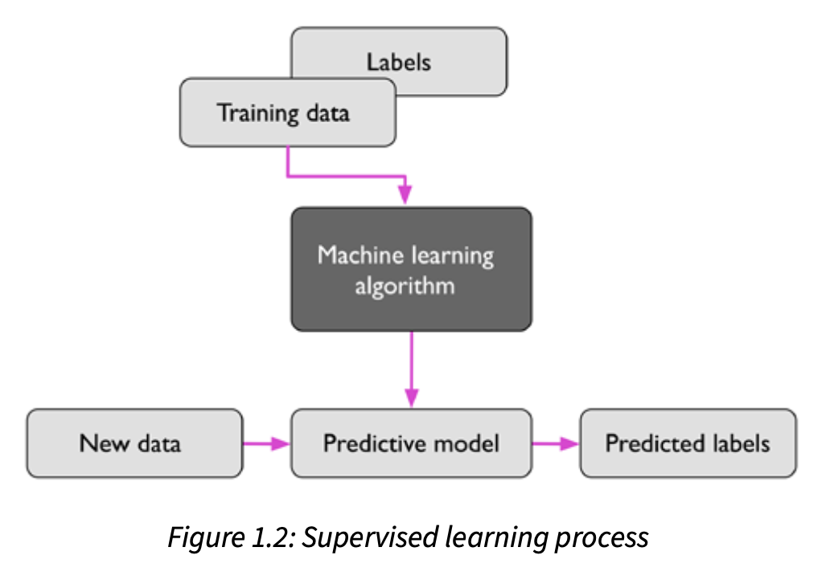
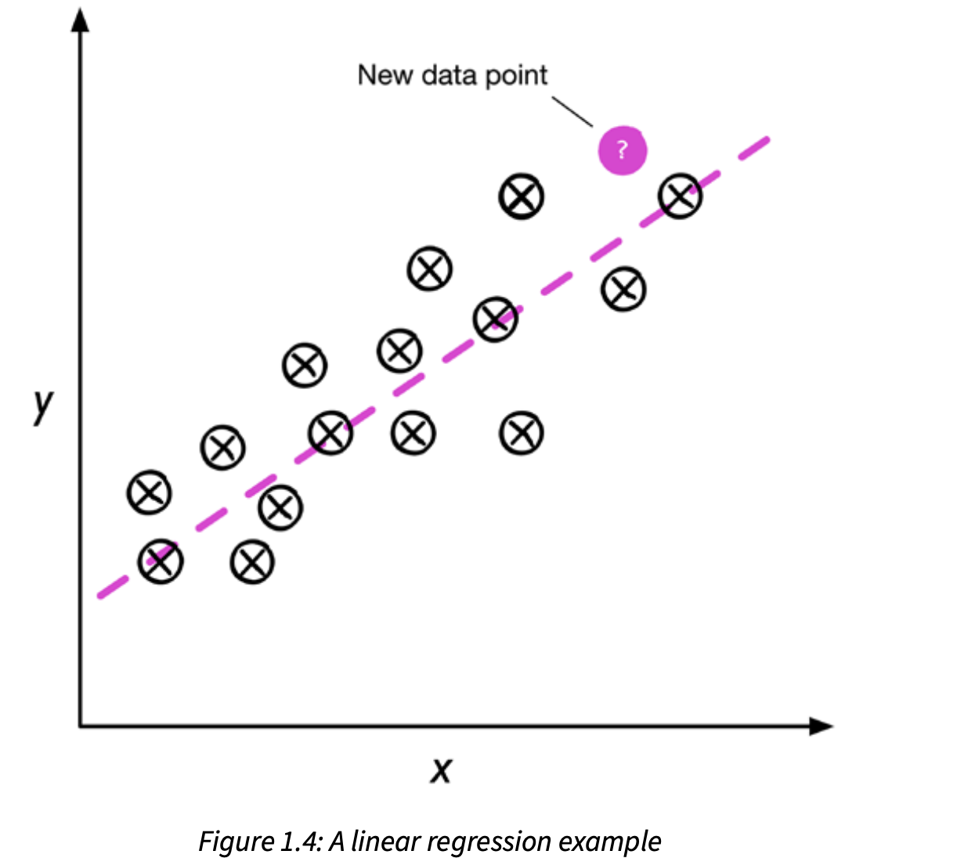
Supervised Learning
Process of modeling the relationship between the input data & labels to make predictions about unseen or future data.
Classification: Supervised learning task with discrete class
Regression: Supervised learning task where outcome is a continuous value

Slide 49
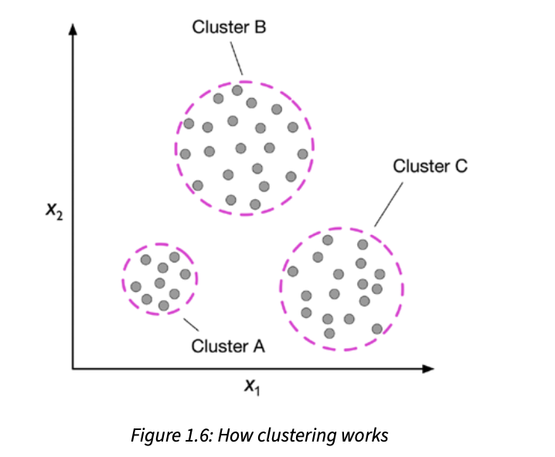
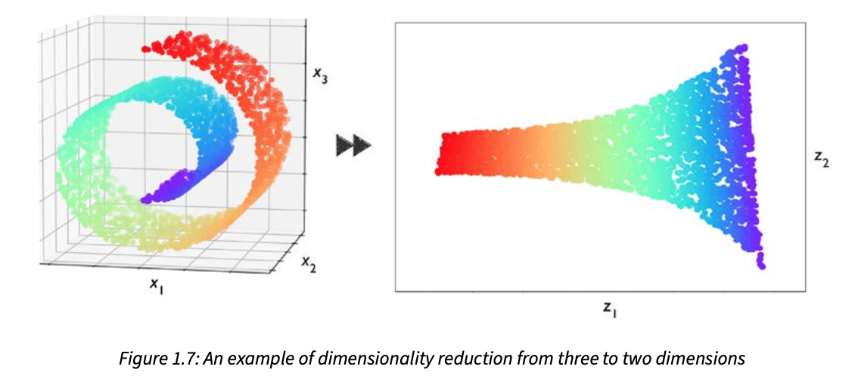
Unsupervised Learning
Deals with unlabeled data, aims to explore the structure of data to extract meaningful information without the guidance of a known outcome.
Clustering: Organize data into meaningful subgroups without having any prior knowledge of their group
Dimensionality reduction: Compresses data into smaller dimension while retaining most of relevant information

Slide 50
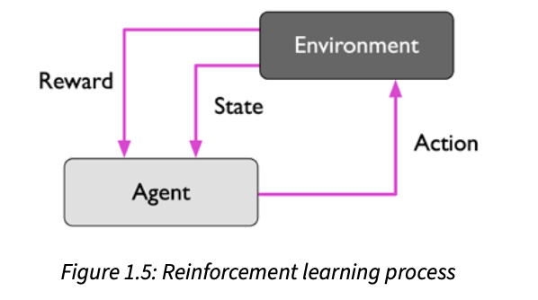
Reinforcement Learning
The goal is to develop a system (agent) that improves its performance based on interactions with the environment.
Action: Interaction with the environment
Reward/Feedback: Measure of how well the action was

Slide 51


Example of Tabular Data
Sample (Instance, Observation):
Each row in the dataset, which is an example of data
Feature (Measurement, Attributes, Variable, Predictor ):
Each column of the dataset which describe an example
Label (Target, Outcome, Class, Dependent variable):
Target variable that model is trained to predict
Matrix notation
of data:

Slide 52


Common Scaling Methods
Min-Max Scaling (Normalization)
Scales features to [0, 1]
Preserves the shape of original distribution
Use when: You want all numbers to fit in the same range, like pixels in an image or percentages
Z-Score Scaling (Standardization)
Centers data at 0 with standard deviation 1
Can produce negative values
Use when: Features have very different sizes or units, like height in cm vs weight in kg,
so each feature contributes equally
Tip: For gradient descent, standardization is usually safer because it avoids huge gradients caused by large feature values.
Notes:
Proper learning rate ensures gradient descent moves efficiently.
Proper feature scaling ensures gradient steps are meaningful in all directions.
Together → faster, stable convergence.

Slide 53






Gradient Descent
Update weights by taking a step in the opposite direction of the gradient of the loss function
Compute Gradient: Take derivatives w.r.t weights & bias:
So the weight update:
So overall:
Notes:
yi​ is constant w.r.t w, so derivative = 0
−(w⋅xi​+b) derivative w.r.t w = −xi​

